Slide 1
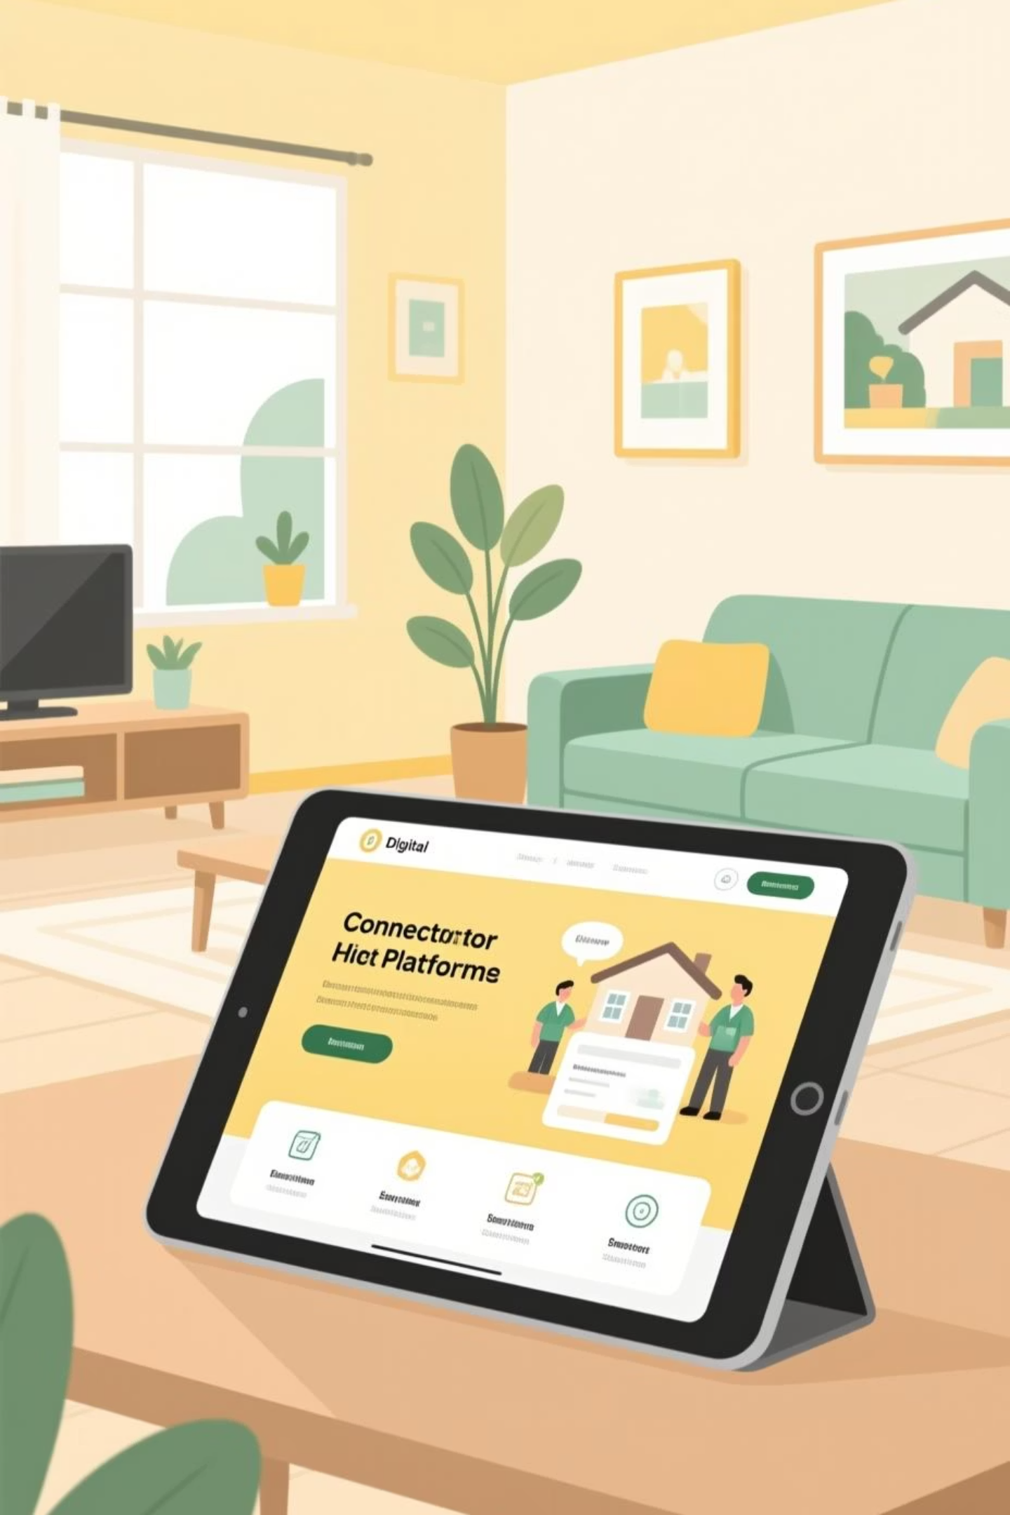
Gharmitra – Your Trusted Home Assistance Platform
Gharmitra offers a smart and intuitive solution, connecting you with reliable home service professionals instantly. Experience peace of mind with expert help at your fingertips, transforming how you manage household needs.

Slide 2


Problem Statement
Finding skilled and trustworthy home service professionals—whether it's a plumber, electrician, carpenter, or moving assistant—can be a significant challenge. Delays and uncertainty often lead to frustration and inconvenience.
The current system often lacks a proper booking mechanism, leading to unpredictable service times, issues with reliability, and inconsistent quality. This creates a cycle of mistrust and dissatisfaction for homeowners and renters alike.

Slide 3


Proposed Solution – Gharmitra
Gharmitra is a cutting-edge digital platform designed to bridge the gap between homeowners and trusted service providers. We connect you with a network of verified professionals, ensuring quality and reliability every time.
Seamless Connection
Quick Booking
Directly link with skilled professionals.
Schedule services efficiently.
Transparent Pricing
Verified Trust
No hidden fees, clear costs.
Reliable, background-checked experts.

Slide 4
Key Features
On-Demand Service Booking
Verified & Trained Professionals
Transparent Pricing
Enjoy clear, upfront costs with no surprises or hidden charges.
Effortlessly schedule services at your convenience, anytime, anywhere.
Access a network of highly skilled and thoroughly vetted experts.
Service Tracking & Updates
Multiple Service Categories
Stay informed with real-time progress and status updates for your service.
Find solutions for plumbing, electrical, carpentry, cleaning, and more, all in one place.

Slide 5




How It Works
01
02
1. Select Your Service
2. Choose Date, Time & Location
Browse through our extensive list of home services and choose what you need.
Specify your preferred schedule and location with just a few taps.
03
04
3. Professional Arrives
4. Pay Securely & Rate
A verified and skilled professional will arrive promptly to complete the job.
Complete your payment securely and share your feedback to help us maintain quality.

Slide 6

Conclusion
Gharmitra is revolutionizing home assistance, making it faster, easier, and more reliable than ever before. We are committed to bringing modern convenience and trust to every household.
Faster & Easier
More Reliable
Streamlined booking and service delivery save you time and effort.
Access verified professionals who deliver consistent, high-quality service.
Modern Home Assistance
Embrace the future of home services with Gharmitra's innovative platform.

